Slide 1
Introduction to Artificial Intelligence
Course Overview and Introduction
By
Seyed Abolghasem Mirroshandel mirroshandel@gmail.com

Slide 2
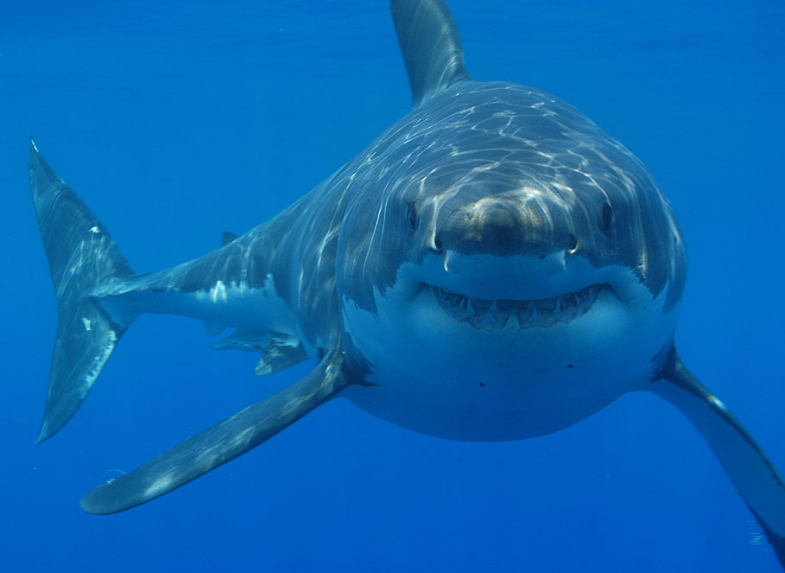
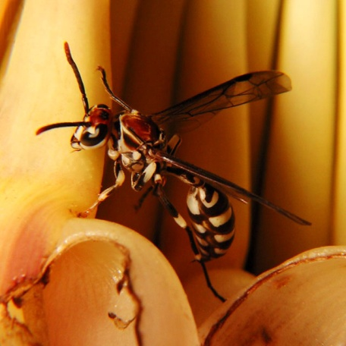
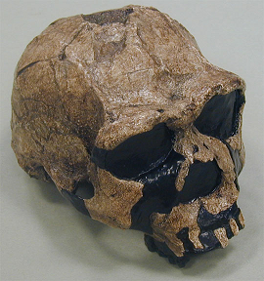
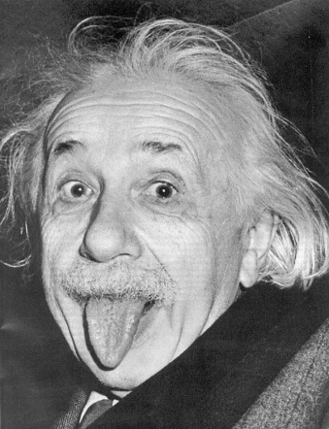
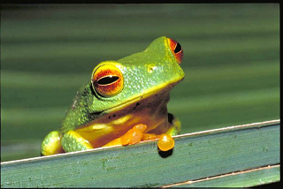
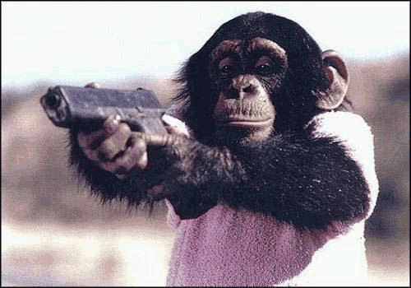
WHAT IS INTELLIGENCE AND WHO IS INTELLIGENT?
Introduction to AI, Guilan University, Fall 2013, Mirroshandel@gmail.com

Slide 3

QUOTES ABOUT INTELLIGENCE
The ability to carry out abstract thinking. (Terman, 1921)
The capacity for knowledge, and knowledge possessed. (Henmon, 1921)
The capacity to learn or to profit by experience. (Dearborn, 1921)
Intelligence is what is measured by intelligence tests. (Boring, 1923)
A global concept that involves an individual's ability to act purposefully, think rationally, and deal effectively with the environment. (Wechsler, 1958)
Intelligence is a general factor that runs through all types of performance. (Jensen)
A person possesses intelligence insofar as he had learned, or can learn, to adjust himself to his environment. (Colvin 1982)
Introduction to AI, Guilan University, Fall 2013, Mirroshandel@gmail.com

Slide 4
QUOTES ABOUT INTELLIGENCE
Intelligence is adaptation to the environment. (unknown)
Intelligence is that faculty of mind by which order is perceived in a situation previously considered disordered. (R.W. Young, 1999)
Intelligent activity consists of grasping the essentials in a given situation and responding appropriately to them. (unknown)
Intelligence is the ability to use optimally limited resources - including time - to achieve goals. (Kurzweil, 1999)
Intelligence is what you do when you don't know what to do. (unknown)
Intelligence is a hypothetical idea which we have defined as being reflected by certain types of behavior. (unknown)
Introduction to AI, Guilan University, Fall 2013, Mirroshandel@gmail.com

Slide 5
WHAT IS ARTIFICIAL INTELLIGENCE? – SAMPLES
Thermostats?
Phones that recognize names?
Spelling auto-correction?
Washers that adjust to weight?
Lights that go off automatically?
Spaceships that cruise automatically for years?
Aircrafts Autopilots?
Games?
…
Introduction to AI, Guilan University, Fall 2013, Mirroshandel@gmail.com

Slide 6
WHAT IS ARTIFICIAL INTELLIGENCE?
To create machines, smarter than previous ones.
To add features to machines which machines don’t have, but human has.
Introduction to AI, Guilan University, Fall 2013, Mirroshandel@gmail.com

Slide 7
ABSTRCTION OF HUMAN LEVEL INTELLIGENCE
Learning
Reasoning
Problem Solving
Perception
  Vision
  Audio
Language
Introduction to AI, Guilan University, Fall 2013, Mirroshandel@gmail.com

Slide 8
FORMAL DEFINITION of ARTIFICIAL INTELLIGENCE
 | Human Level | Rational
Behavior | Systems that behave like humans. | Systems that act rationally.
Thinking | Systems that think like humans. | Systems that think rationally.
Introduction to AI, Guilan University, Fall 2013, Mirroshandel@gmail.com

Slide 9
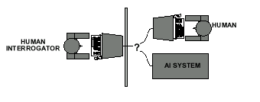
Turing Test
If the human cannot tell if it is a computer or a human, the program exhibits intelligence
Introduction to AI, Guilan University, Fall 2013, Mirroshandel@gmail.com

Slide 10

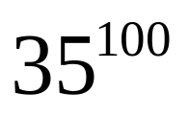
Why is AI different than conventional programming?
Strive for
  GENERALITY
  EXTENSIBILITY
For example in chess: we have possible games
Tackle problems with no algorithmic solution
Represent and manipulate KNOWLEDGE, rather than DATA
A new set of representation and programming techniques: HEURISTICS
Introduction to AI, Guilan University, Fall 2013, Mirroshandel@gmail.com

Slide 11
Example: TIC-TAC-TOE
Introduction to AI, Guilan University, Fall 2013, Mirroshandel@gmail.com

Slide 12
Strategy 1: hard wired
Code a table of all possible board positions and the transitions between them (state diagram)
Given a position, look in the table for the next move and return
Properties:
  time efficient, requires lots of storage
  not extensible: requires a table for other games
Introduction to AI, Guilan University, Fall 2013, Mirroshandel@gmail.com

Slide 13
Strategy 2: less hard wired
Use procedures designed for the game:
  try to place two marks in a row
  if opponent has two marks in a row, place mark in third space
Pattern matching to recognize board positions
Can encode different playing strategies
Better space efficiency, less time efficiency
Still game-dependent
Introduction to AI, Guilan University, Fall 2013, Mirroshandel@gmail.com

Slide 14
Strategy 3: AI-like
Represent the state of the game:
  current board position
  next legal positions
Use an evaluation function:
  Rate the next move according to how likely it will lead to a win
  look-ahead of possible opponent moves
More general because it embodies a general strategy.
Introduction to AI, Guilan University, Fall 2013, Mirroshandel@gmail.com

Slide 15
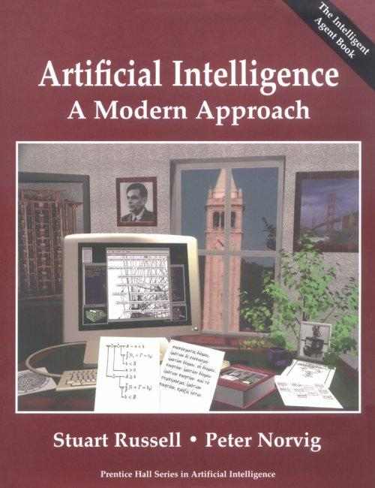
TEXT BOOK
Chapters 1 ~ 10
Search, Games
Logic & Reasoning
+
Some additional parts, if possible.
Introduction to AI, Guilan University, Fall 2013, Mirroshandel@gmail.com

Slide 16
ASSESSMENTS
Exercises (2 ~ 3 points)
Mid Term Exam (5 ~ 6 points)
Final Exam (8 ~ 9 points)
Final Project ( 4 ~ 5 points)
Introduction to AI, Guilan University, Fall 2013, Mirroshandel@gmail.com

Slide 17
Warnings
If the exams sum < 50%, it would be multiplied in Exercises and Project.
The deadlines are deadly serious.
Any dishonesty in exercises may have effect on all exercises.
If this is your last term, if you want to keep your grades high, if..., study and exercise.
Introduction to AI, Guilan University, Fall 2013, Mirroshandel@gmail.com

Slide 18
Contacts
Join:
http://groups.yahoo.com/group/azahra_ai/
You can email me:
mirroshandel@gmail.com
Introduction to AI, Guilan University, Fall 2013, Mirroshandel@gmail.com

